Slide 1
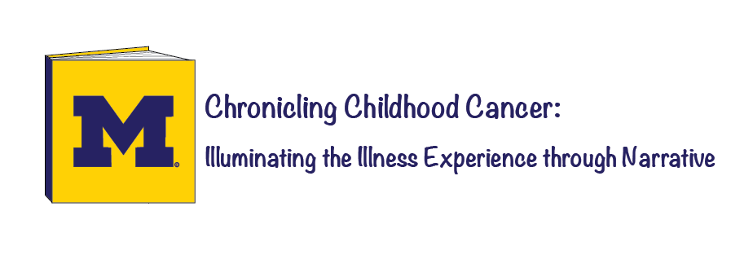
Trisha Paul
Notes:
Good afternoon everyone, my name is Trisha Paul. I’m a senior at the University of Michigan majoring in English with minors in Biochemistry and Medical Anthropology. Today I would like to talk to you about the research project that I initiated for my Honors thesis in English, a project called Chronicling Childhood Cancer: Illuminating the Illness Experience through Narrative.
I’ve been volunteering with Pediatric Oncology in-patients at C.S. Mott Children’s Hospital for 5 years now; I’ve really enjoyed spending time with these children amidst their traumatic experiences with cancer. I aspire to attend medical school and, largely because of my experiences with these children, I hope to become a Pediatric Oncologist myself.
Over the years, I have observed cancer’s disruptive nature in the lives of each patient and their families: the imprisonment of IV poles, the pain of pokes, the side effects of chemotherapy, even the fear of death. As I witnessed these unique and personal experiences of cancer, I became interested in understanding how these children cope with this complex, mysterious illness. My research explores how children with cancer express their experiences with illness by writing, drawing, and/or speaking about cancer. This is an ongoing research project that began this summer, so today I will be presenting some of my current findings and ideas for the future.

Slide 2

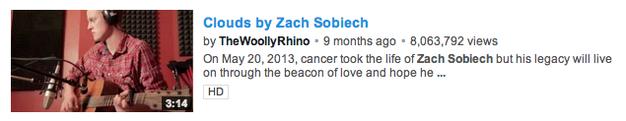
What are Illness Narratives?
“Expressions about or around the experience of being ill”
Notes:
I’d like to start off by taking a step back to talk a bit about the creation of this research project and where the idea came from. As an English major, I became intrigued by the intersection of literature and medicine, particularly as seen through illness narratives, or pathographies. In studying this genre, I’ve come to personally define illness narratives as “expressions about or around the experience of being ill.” These experiences can be portrayed from different points of view within and outside of the medical sphere, by patients, health professionals, and loved ones. They can be brought to life through a variety of different mediums such as written word, song, or even dance.
Angelina Jolie’s recent opinion piece in the NYTimes, for example, illuminates her medical decisions in the face of a breast cancer threat. Zach Sobiech, a teenager with osteosarcoma, expressed his terminal illness by composing songs; his song Clouds has over 8 million views on YouTube. Illness narratives have become ever-present in our society, and these experiences of illness and its surroundings are becoming more acknowledged and appreciated.

Slide 3

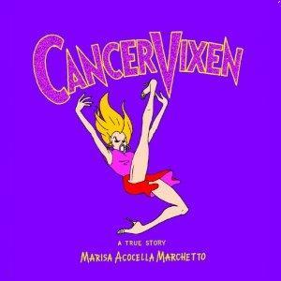
Literary Illness Narratives about Cancer
Notes:
Within the expansive genre of illness narratives, I’ve become primarily interested in memoir and autobiographical works of literature written by the ill. My interest in oncology drew me to cancer narratives in particular such as Audre Lorde’s The Cancer Journals or Marisa Marchetto’s Cancer Vixen. But I was surprised to find that there were hardly any literary narratives about the experience of childhood cancer.

Slide 4

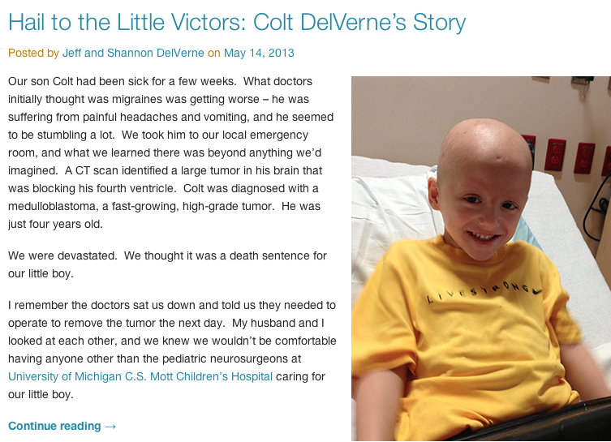
Notes:
What I’ve seen is that many of the illness narratives written about childhood cancer are written through another set of eyes. Mott Children’s Hospital, for example, does in fact have a blog where we feature many different children, but these stories are told from a reporter’s perspective, a doctor’s perspective, or a parent’s perspective. But what concerned me is that these children who experience cancer themselves rarely have the chance to tell their story. And as an aspiring Pediatric Oncologist, I became interested in giving these children the chance to share their own stories.

Slide 5

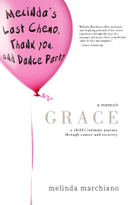
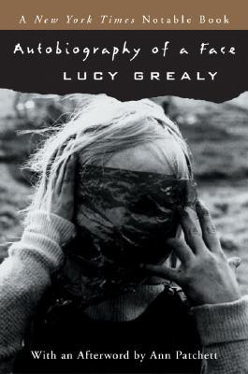
Childhood Cancer Narratives
Notes:
After further investigation, I encountered a few memoirs about childhood cancer. But what I noticed was that these published narratives about the childhood cancer experience were all written by children years later. These works were all retroactive reflections on their lived cancer experience, but I believed that there was something to gain from capturing the living experience of childhood cancer. Since cancer is a way of life for so many children and adolescents, I hoped that narrative would reveal more about the reality of childhood cancer.

Slide 6
The Idea
Explore how children with cancer express their experience through narrative:
  Writing
  Drawing
  Speaking
Understand how children conceptualize cancer
Witness illness expression through narrative
Notes:
This is the fundamental purpose behind my English thesis research. My goal is to understand how children with cancer express their illness through narrative, and I’m giving them the opportunity to do this by writing, drawing, and/or speaking about their cancer. There are three primary questions that I am currently focusing on, which I will address throughout this talk:
What does narrative illuminate about the living experience of childhood cancer?
How do children conceptualize cancer and make sense of their illness experiences?
How does cancer at a time of coming-of-age influence the development of an adolescent self?
In addition to exploring these questions, I wanted to witness this narrative creation to explore how the expressive process affected each child.

Slide 7
Participants
Pediatric Oncology patients at C. S. Mott Children’s Hospital
  Inpatients
  Outpatients
Ages 10-17
  Now including ages 8-21
Notes:
The participants in this research project are Pediatric Oncology patients at Mott Children’s Hospital. These children include both inpatients staying at the hospital and outpatients stopping in for doctor’s appointments, blood tests, and drug infusions. We began with 10-17 year olds, focusing on the adolescent period, and we’ve just recently expanded the age range to 8-21 year olds to better capture the childhood and young adult cancer experience. Eligible participants are identified and suggested by members of the care team such as physicians, nurses, and child life specialists. Recruitment materials also allow patients and families to get directly involved if they are interested in participating.

Slide 8
Activity
Child can tell their story as they wish through:
  Writing
  Drawing
  Speaking
  All of the above
Prompting questions guide child
Post-activity survey
Notes:
The interactions that I have had with each child have been entirely different experiences. For most patients, I sit down with each child. We have a conversation about their lives and their personal experiences with cancer, with the questions serving merely as a guide. Most children chose to talk about it first and to create the storybook afterwards, but some write and draw while speaking. Others preferred to work on the blank storybook independently rather than to speak about their experiences. I purposefully designed this research to be as flexible and accommodating to the desires of each child; this has proven to be crucial with the diverse comforts and interests of these children and with the unpredictability of out-patient appointment times and in-patient hospital stays. Following the activity, patients complete a short survey to reflect on how the activity made them feel and their personal preferences with different mediums. This was included to get a sense of which mediums children preferred and what it is about particular mediums that resonated with different children.

Slide 9
Activity- Prompts
Diagnosis
Symptoms
Hospital
Treatment
Advice
Reflections
Notes:
The guiding questions were designed to address different components of the childhood cancer experience. These touched upon the milestone events such as feelings around the moment of diagnosis, definitions and understandings of cancer, time spent in the hospital, and side effects of treatment. These questions were phrased as openly as possible to give children the space for honesty, questions such as “What do you like and not like about being in the hospital?” Or “What is cancer?”
From the onset, one of the driving motivations for participating in this research is to help other kids with cancer. Children have a chance to reflect on their own experiences and to share what they’d like other kids to know. One of the final questions that I lead up to is “Has cancer changed your life?” This question forces children to recognize their personal and intimate encounters with cancer.

Slide 10


After Activity- Patients
Keep hard copy of narrative
Opportunity to publish their story
Notes:
Perhaps what I am most excited about with this research project is that children who participate in the written and drawn component will have the opportunity to publish their story. We will be publishing a book of patient narratives; this will give children a chance to share their stories with health professionals, loved ones, and other children with cancer. This research project has always been about the children and for the children, and I am glad that they will have the chance to have their voices heard.

Slide 11
Participant Observation
From volunteer to researcher
Trust amidst patients, families, providers
Communicate with children as equals
Converse in language of childhood cancer
Notes:
From an anthropological perspective, I like to think about this as an example of participant observation research. On the 7th floor of Mott, I have two roles. On Friday evenings, I am a volunteer in a blue uniform just as I have been for the past 5 years. I am someone who helps run the in-patient playroom and play with children at their bedside. But at other times, I am here as a researcher, as someone working with patients on a more professional level. I think my presence in different capacities has allowed me to gain the trust of health care professionals, patients, and families.
My role as a volunteer helps children to see me as an equal and bridges the age gap so that I can accompany children as they express their experiences rather than explore these as an outsider. From the language of childhood cancer to the fear of pokes, anxiety about blood counts, the inconsistencies of appointment times, and the inpatient and outpatient lifestyles, there are many aspects that I have better understood through these dual roles. These have helped me to conduct my narrative research more effectively within this delicate setting.

Slide 12
Narrative Intervention
“Doubly vulnerable subjects”
  Adolescence
  Illness
Questions guide narrative construct
Physical presence may influence written text
Notes:
At the same time, I think that it is important to recognize how I have shaped these narratives through my guiding questions and my presence.
What’s interesting about working with pediatric oncology patients is that they can be understood to be what G. Thomas Couser would call “doubly vulnerable.” Adolescents with cancer are “vulnerable in two dimensions” due to their youth and their illness. With the dual vulnerability of these patients, narrative methodology such as the questions that I ask and how they are phrased is particularly influential on what emerges in these narratives. My physical presence can also influence creation of these texts and the narrative product.
--
Couser, G. Thomas. Vulnerable Subjects: Ethics and Life Writing. Ithaca: Cornell UP, 2004. Print.

Slide 13
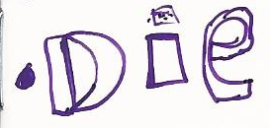

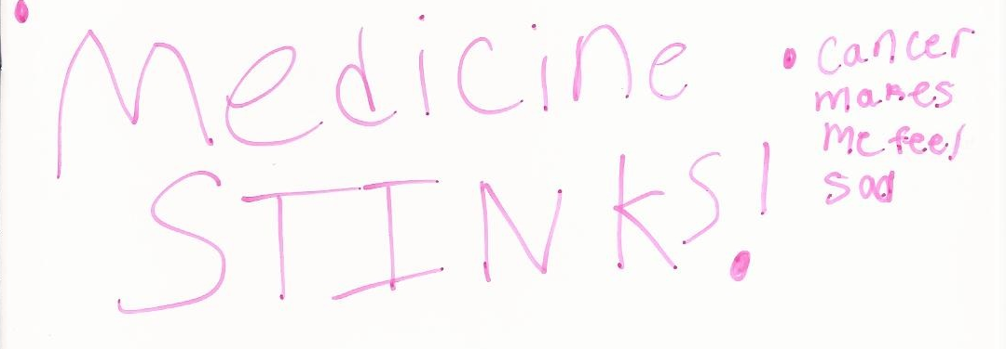
“The World of Childhood Cancer”
Notes:
There are three particularly unique qualities to childhood cancer that contextualize and clarify these narratives.
First and foremost is the familiarity with cancer as a deadly disease. A number of children responded to their initial diagnoses with fears, one even defining cancer as “something you can die from.” Childhood cancer is in fact the number one cause of death for children, second only to accidents, but survival rates over the years have grown tremendously; it is no longer the death sentence that it once was. The omnipresent and somber nature of adult cancer also tends to overshadow the real possibility for hope and survival in childhood cancer.
Just as with adult cancer, childhood cancer also evokes similar metaphors of battle and violence. As explored by Susan Sontag in Illness as Metaphor, cancer becomes a fight, an enemy, an evil. This perception permeates these narratives as children are determined to demonstrate their strength by emerging from cancer as a victorious survivor. As seen here, there is a desire to “take out cancer.”
Thirdly, cancer treatment itself is complex because of its dangerous side effects. Chemotherapy is a drug, a poison, and radiation is a penetrative, intense attack on cells. These visible side effects such as hair loss or vomiting made it hard for some children to find the good in treatment. It’s challenging for children to realize the longterm benefits and ultimate purpose behind treatment, but perhaps that is something that we can further emphasize to improve the childhood cancer experience.

Slide 14
Spoken
“I don’t think that I’ve ever really spoken about my cancer this much”
Notes:
I’d now like to consider some of the particularly compelling findings of each medium, beginning with the spoken word. Please take a moment to read this slide.
In a dimly lit inpatient room, a 17 year old teenager chose to talk with me about his experiences. With his eyes closed, he spoke as if he were no longer in the present but rather reliving each memory that he recounted. My presence was invisible and unintrusive, passive rather than active. But after an hour went by and our conversation drew to a close, he told me candidly that he didn’t think he had ever really spoken about his cancer that much.
I was taken aback to realize the incredible power of presence, to realize that the stories of these children are rarely given the space to emerge. Patient encounters can be driven by constricting questions, but this activity allowed the teenager to steer the conversation wherever he wanted to go. While that can be empowering, it can also be an emotional experience. For some kids, the liberating control of confronting cancer with words forced them to recognize the reality of their situations and diminished their fascades of strength.

Slide 15
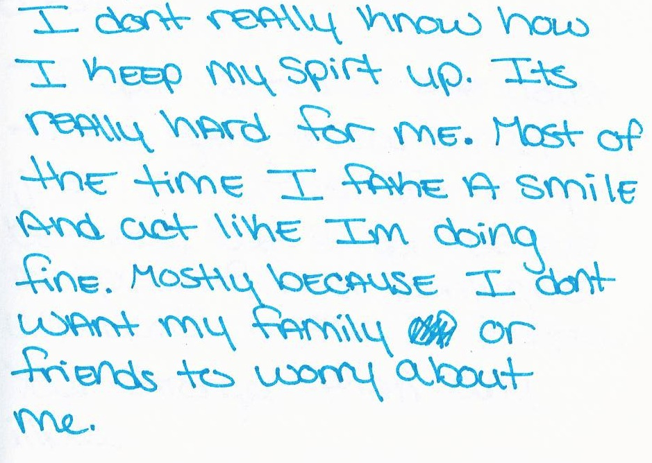
Written
Notes:
Please take a moment to read this sentence. (PAUSE)
This 16 year old girl introduced herself to me as someone who was shy. We were in the infusion clinic with her beeping IV machine audibly inserting itself into our dialogue. She seemed a bit reserved during our verbal conversation, but it was her writing that revealed to me how much had been left unspoken. What emerges through other narrative mediums that may otherwise not be visible? She wrote this quote afterwards, admitting to her unexpressed and perhaps unknown tendencies. While this emotional disillusion remained hidden in our verbal conversation, the act of writing allowed her thoughts to surface.

Slide 16
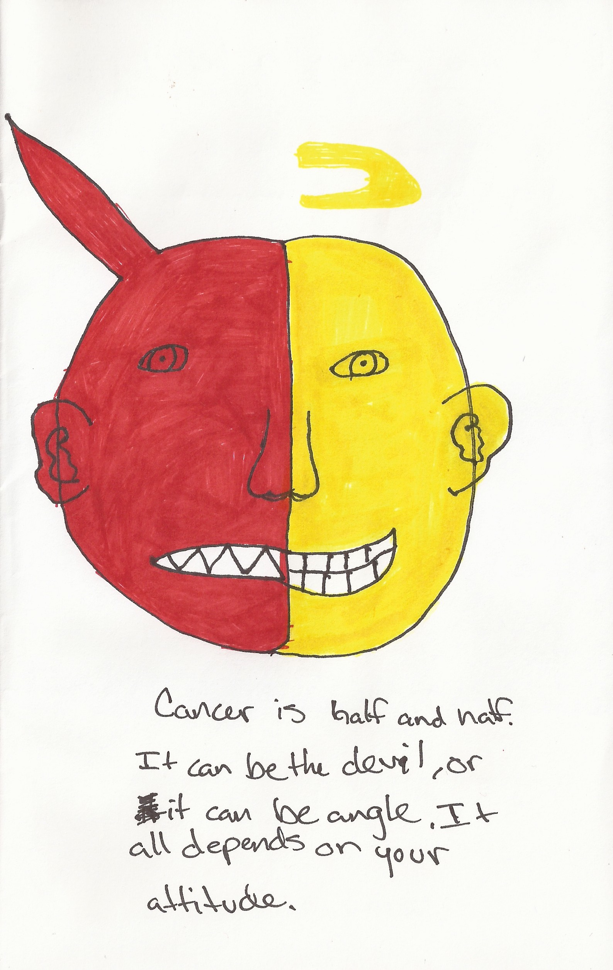
Drawing
Notes:
Please take a moment to read this slide.
This 16 year old boy was initially hesitant to participate, but he decided that it would be worth it if he could help other kids with cancer. He was in remission and had just come in for a doctor’s visit. As he began to answer my questions, he also began to draw the outline of a figure he would later call “cancer.”
How do children conceptualize cancer? This teenager draws cancer as part evil and part good. He personifies cancer to the extremes of good and bad, empowering the disease as a being. But to him, cancer’s identity is fluid and instead dependent on a child’s own view. This is both a demanding and liberating charge: on one hand, it empowers the child to take control over their illness. But at the same time, it burdens the child with responsibility over their cancer. While he hated the treatments, he recognized the once-in-a-lifetime opportunities that came out of his cancer such as meeting star athletes at Michigan. He illuminates a duality within the cancer experience, a combination of the good and bad.

Slide 17
Coming-of-Age with Cancer
“Speak up. It is so important for you to voice your opinion because the doctors and nurses can sometimes fix things…”
Notes:
Please take a moment to read this written quote.
This teenager is actually someone that I spent time with as a volunteer years before working with her as a researcher. She was diagnosed at the age of 2 and is now on her 5th relapse of cancer. Her written advice illuminates a number of tensions that are entangled with this experience. While she advocates for patients to take charge of their diseases and “speak up,” she also recognizes the limitations to patient power by remembering that doctors and nurses are the ones who can fix things. This demonstrates the tension of being an adolescent with cancer: a struggle to be a passive, obedient, good patient while growing up and becoming an independent individual with agency. Cancer complicates the coming-of-age process and shapes the adolescent self in subtle ways that reveal themselves through narrative.

Slide 18
Further Research
Medium:
  Video, Photos, Social Media platforms
Technology:
  Create interactive compilation of narratives
  Multimedia iBooks, online gallery
Notes:
This research has encouraged me to think further about how to capture the living childhood cancer experience. There is potential to incorporate other mediums such as video, photography, or social media so that children can further personalize their expressions based on the mediums that they are most comfortable with. Recognizing the comfort zones of adolescent expression and adapting this research project accordingly could be very effective.
After creating the book publication of these works, I hope to adapt this to a technological format. Creating an e-book will open up multimedia opportunities to incorporate voice and video. This will be a more accessible and interactive format for pediatric oncology patients.

Slide 19
Medical Implications
Narrative awareness enables improved understanding and recognition of child values
Personalize care and treatment to each child’s unique personalities and preferences
Enhance a child’s understanding of illness to help them better cope with cancer
Notes:
I believe that this research project can help us to better understand each child with cancer individually. Narrative can help to reveal the unique characteristics of each child ‘s experience with cancer, and by recognizing these personal qualities, we can act accordingly. One child felt that cancer hasn’t changed his life because he can still do everything that he could before. In recognizing this, maybe we can prioritize his abilities when considering treatment options. Narrative reveals ways that we can enhance the childhood cancer experience, and it is then our responsibility to incorporate these findings in our own practice.

Slide 20
Conclusions
How children tell their story can provide insight into personal illness experiences and values.
Narrative can illuminate understandings of illness and its influences on the adolescent self.
Only in appreciating these unique experiences, I believe, can we work together to understand and treat the many facets of cancer.
Notes:
In working with a doubly marginalized population, the living narratives of pediatric oncology patients have demonstrated how much we can learn about childhood cancer through child narratives. Narrative not only exposes how children understand and cope with their illness, but it also reveals how cancer has affected their own becoming. We must recognize these invisible symptoms of cancer so that we can address them. Only in appreciating these unique experiences, I believe, can we work together to understand treat the many facets of cancer.

Slide 21



Special Thanks to Sponsors
Department of Pediatrics
Division of Pediatric Hematology/Oncology
Notes:
I’d like to specially thank my sponsors at the University of Michigan: The Department of Pediatrics, Division of Pediatric Hematology/Oncology, the Department of English, and the Honors Program. Their support has enabled me to Initiate this original, interdisciplinary research and continue to develop it.

Slide 22
Special Thanks to Supporters
Dr. Rajen Mody (Pediatrics Hematology/Oncology)
Professor Melanie Yergeau (English)
C.S. Mott Children’s Hospital, University of Michigan
  Pediatrics Hematology/Oncology Staff
  Patients and families
Notes:
I would like to thank Dr. Rajen Mody, a pediatric oncologist and the PI for this research project who has encouraged me to grow this project more than I could ever have imagined. My advisor in the English Department, Professor Melanie Yergeau, has listened patiently to my ideas since the early inception of this research.
I would also like to express my gratitude to the Pediatric Hematology/Oncology staff at C.S. Mott Children’s Hospital - this project would never have been the same without the people at this hospital. Most importantly, I am grateful to the patients and families at Mott who have supported and engaged in my research project. It is inspirational to see these children selflessly want to help others with cancer. I value the relationships that I have built with these patients and families, and it has been an honor to work with these people.

Slide 23
Thank you
Trisha Paul tkpaul@umich.edu illnessnarratives.com
Notes:
This project is certainly a work-in-progress, and there is much left to explore about the childhood cancer experience. But I’m excited by how far it has come, and I look forward to watching it grow in the future. Thank you.
----- Meeting Notes (9/26/13 23:22) -----
the fault in our stars-
audience

