Slide 1
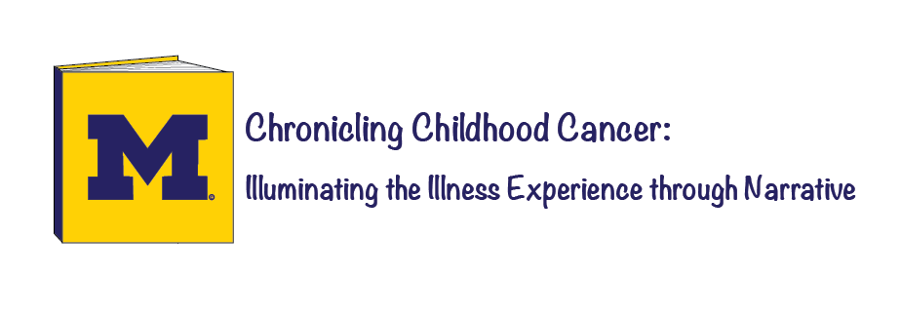

Trisha Paul
University of Michigan
This work is licensed under a Creative Commons license: BY-SA.
Notes:
Good morning everyone, my name is Trisha Paul. I’m a senior at the University of Michigan majoring in English with minors in Biochemistry and Medical Anthropology. Today I would like to tell you about the research project that I initiated for my Honors thesis in English, a project called Chronicling Childhood Cancer: Illuminating the Illness Experience through Narrative. In this session, I will share with you my research methodology and the narratives that I have collected from children with cancer. We will discuss the ethics of such narrative research, the findings encountered within these narratives, and the potential impact of this project.
To begin with, I’ve been volunteering with pediatric oncology inpatients at C.S. Mott Children’s Hospital for 5 years now; I’ve really enjoyed spending time with these children amidst their often traumatic experiences with cancer. I will be attending the University of Michigan Medical School this fall and, largely because of my experiences with these children, I hope to become a Pediatric Oncologist myself.
Over the years, I have observed cancer’s disruptive nature in the lives of each patient and their families: the imprisonment of IV poles, the pain of pokes, the side effects of chemotherapy, even the fear of death. As I witnessed these unique and personal experiences of cancer, I became interested in understanding how these children cope with this complex, mysterious illness. My research explores how children with cancer express their experiences with illness by writing, drawing, and/or speaking about cancer. This is an ongoing research project that began last summer, so today I will be presenting some of my current findings and ideas for the future.

Slide 2
“I don’t think that I’ve ever really spoken about my cancer this much”
-Andy, age 17, in treatment

Slide 3

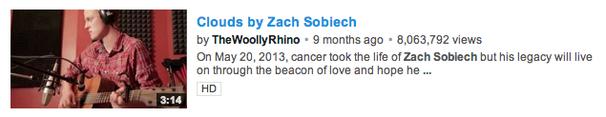
What are Illness Narratives?
“Expressions about or around the experience of being ill”

Slide 4


Literary Illness Narratives about Cancer

Slide 5

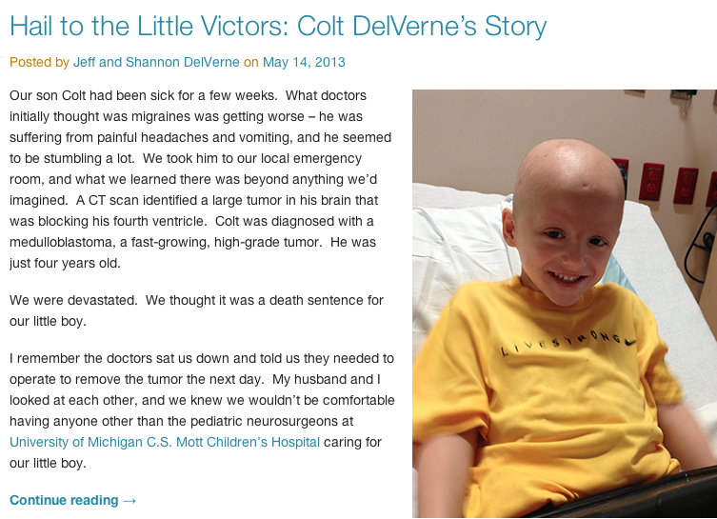

Slide 6

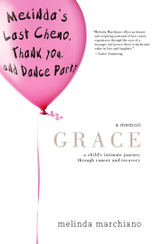

Childhood Cancer Narratives

Slide 7
The Idea
Explore how children with cancer express their experience through narrative
Witness illness expression through narrative

Slide 8
Primary Topics
Methodology to elicit narratives
Conceptualizations of cancer and treatment
Creation of a self with cancer
Implications of process and product

Slide 9
Participants
25 Pediatric Oncology patients at C. S. Mott Children’s Hospital
  Inpatients
  Outpatients
Ages 10-17
  Now including ages 8-21

Slide 10
Activity
Child can tell their story as they wish through:
  Writing
  Drawing
  Speaking
  All of the above
Prompting questions guide child
Post-activity survey

Slide 11
Activity- Prompts
Diagnosis
Symptoms
Hospital
Treatment
Advice
Reflections

Slide 12


After Activity- Patients
Keep hard copy of narrative
Opportunity to publish their story

Slide 13
Questions?

Slide 14
Discussion- Methodology
Adolescent Involvement
  Participation
  Settings
  Motivations
Researcher Intervention
  Questions
  Risks
  Analysis

Slide 15
Small group activity- Narratives

Slide 16
Discussion- Implications
Narrative as a Process
  Interactive, open-ended methodology
Narrative as a Product
  Genre of illness narratives
  Medical education
  Clinical practice

Slide 17
Concluding Thoughts

Slide 18
“In reality you don’t know… you don’t anything what I’m going through…
you just know the story.”

Slide 19
Further Research
Effects of narrative expression and reception
Medium:
  Video, Photos, Social Media platforms
    Facebook, Twitter, Instagram, Youtube
Cancer diagnosis and treatment
Technology:
  Interactive multimedia iBooks, online gallery

Slide 20
Conclusions
How children tell their story can provide insight into personal illness experiences and values
Narrative can illuminate understandings of illness and its influences on the adolescent self
Only in appreciating these unique experiences, I believe, can we work together to understand and treat the many facets of cancer
Notes:
In working with a doubly marginalized population, the living narratives of pediatric oncology patients have demonstrated how much we can learn about childhood cancer through narrative. Narrative not only exposes how children understand and cope with their illness, but it also reveals how cancer has affected their own becoming. We must recognize these invisible symptoms of cancer so that we can appropriately address them. Only in appreciating these unique experiences, I believe, can we work together to understand and treat the many facets of cancer.

Slide 21
Thank you.
Trisha Paul tkpaul@umich.edu illnessnarratives.com
@trishakpaul2
Notes:
With my dedication to youth with cancer, I believe that this research functions as a gateway for further investigation, for there is much left to explore about experiences of childhood cancer. But I’m excited by how far this research has come, and I look forward to continuing my explorations of childhood cancer in the future. Thank you.

Slide 22
Special Thanks to Supporters
Dr. Rajen Mody (Pediatrics Hematology/Oncology)
Professor Melanie Yergeau (English)
C.S. Mott Children’s Hospital, University of Michigan
  Pediatrics Hematology/Oncology Staff
  Patients and families
Notes:
I would like to thank Dr. Rajen Mody, a pediatric oncologist and the PI for this research project who has encouraged me to grow this project more than I could ever have imagined. My advisor in the English Department, Professor Melanie Yergeau, has listened patiently to my ideas since the early inception of this research, and her mentorship has been essential to the development of this project.
I would also like to express my gratitude to the Pediatric Hematology/Oncology staff at C.S. Mott Children’s Hospital - this project would never have been the same without the people at this hospital. Most importantly, I am grateful to the patients and families at Mott who have supported and engaged in my research project. It is inspirational to see these children selflessly want to help others with cancer. I value the relationships that I have built with these patients and families, and it has been an honor to work with these people.

Slide 23



Special Thanks to Sponsors
Department of Pediatrics
Division of Pediatric Hematology/Oncology
Notes:
I’d like to specially thank my sponsors at the University of Michigan: the Department of English, the Department of Pediatrics, Division of Pediatric Hematology/Oncology, and the Honors Program. Their support has enabled me to initiate, develop, and share this interdisciplinary research.

