Slide 1
HLEQ 430: Narrative Medicine and Health Inequity
Week 3: Diagnosing Illness Narratives
Trisha K. Paul, MD
Spring 2023

Slide 2

The Authors Corner:
Ann Jurecic, Illness as Narrative

Slide 3
“Where did [illness narratives] come from?
Why are we so interested in reading them now?
Why are so many people interested in writing them now?”
-Ann Jurecic, Illness as Narrative
Notes:
Who is telling these stories and who is the intended audience? What is the purpose of narrating illness?

Slide 4
What are Illness Narratives?
“Expressions about or around the experience of being ill”
Can take many forms
  Art
  Film
  Dance
  Literature
Can be told from a variety of different perspectives
  Health professionals, caregivers
  Loved ones (family, friends)
  Those with illness
Notes:
Also known as Pathographies: “autobiographical or biographical narrative about an experience of illness” (229) from Literary scholar Anne Hunsaker Hawkins (1999) in Reconstructing Illness: Studies in Pathographies.

Slide 5
Disease vs. Illness
Distinction coined by sociologist Arthur Kleinman (1988) in Illness Narratives: Suffering, Healing, and the Human Condition
Disease | Illness
Pathological, biological condition | “Innately human experience of symptoms & suffering”
Objective | Subjective
Rooted in mental/physical | Rooted in personal experience

Slide 6

The Medical Gaze
Michael Foucault’s The Birth of the Clinic: An Archaeology of Medical Perception (1963)

Slide 7
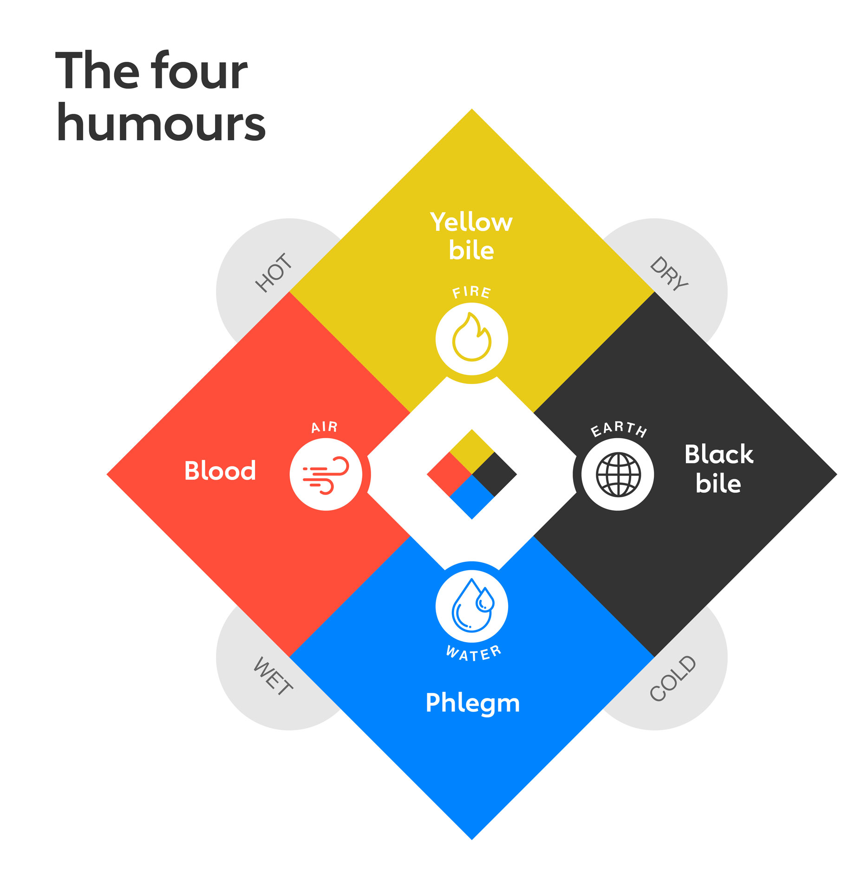
Evolution of Medicine
Until 18th century:
  Hippocrates’ Humors in Medicine
Early 19th century:
  Enlightenment idea of empiricism relies on observation of physical phenomena to understand the body, i.e. Germ Theory
Modern Medicine:
  Technology, scientific research, overmedicalization, i.e. death
Notes:
Humors as a predominant European and Islamic philosophy. The Human body contains blood, phlegm, yellow bile, and black bile.- health is balance mix, pain/disease due to imbalance (deficiency or excess).
Technology advances, Progress in scientific research
Growing emphasis on treating the ‘disease’ (Emphasis on treating the disease inherently privileged the body and physical ailments. )
Increased medicalization, i.e. death in the hospital instead of home
Narratives arose in response to the increased medicalization of illness: enabled patient empowerment through expression

Slide 8
Evolution of Narrative
Until 1950s:
  Autobiography as accurate, undisputable account of the cohesive self
1960s:
  Self as socially and culturally constructed, begins to disrupt traditional autobiographical representations
1970s:
  Autobiography increasingly focuses on the self in discord
  Increasingly embraced by women’s studies, ethnic studies, African American studies, Holocaust studies
  Method of giving voice to the experiences of marginalized populations
Notes:
Increased medicalization -> patient empowerment through expression

Slide 9
Susan Sontag’s Illness as Metaphor (1978)
Explored how prevalent metaphors and myths surrounding certain illnesses (cancer, TB, AIDS) add to patient suffering
“Any disease that is treated as a mystery and acutely enough feared will be felt to be morally, if not literally, contagious”
Notes:
Written while she was a patient with cancer.
An example of how stigma informed narratives about illness which contributed to health inequity

Slide 10
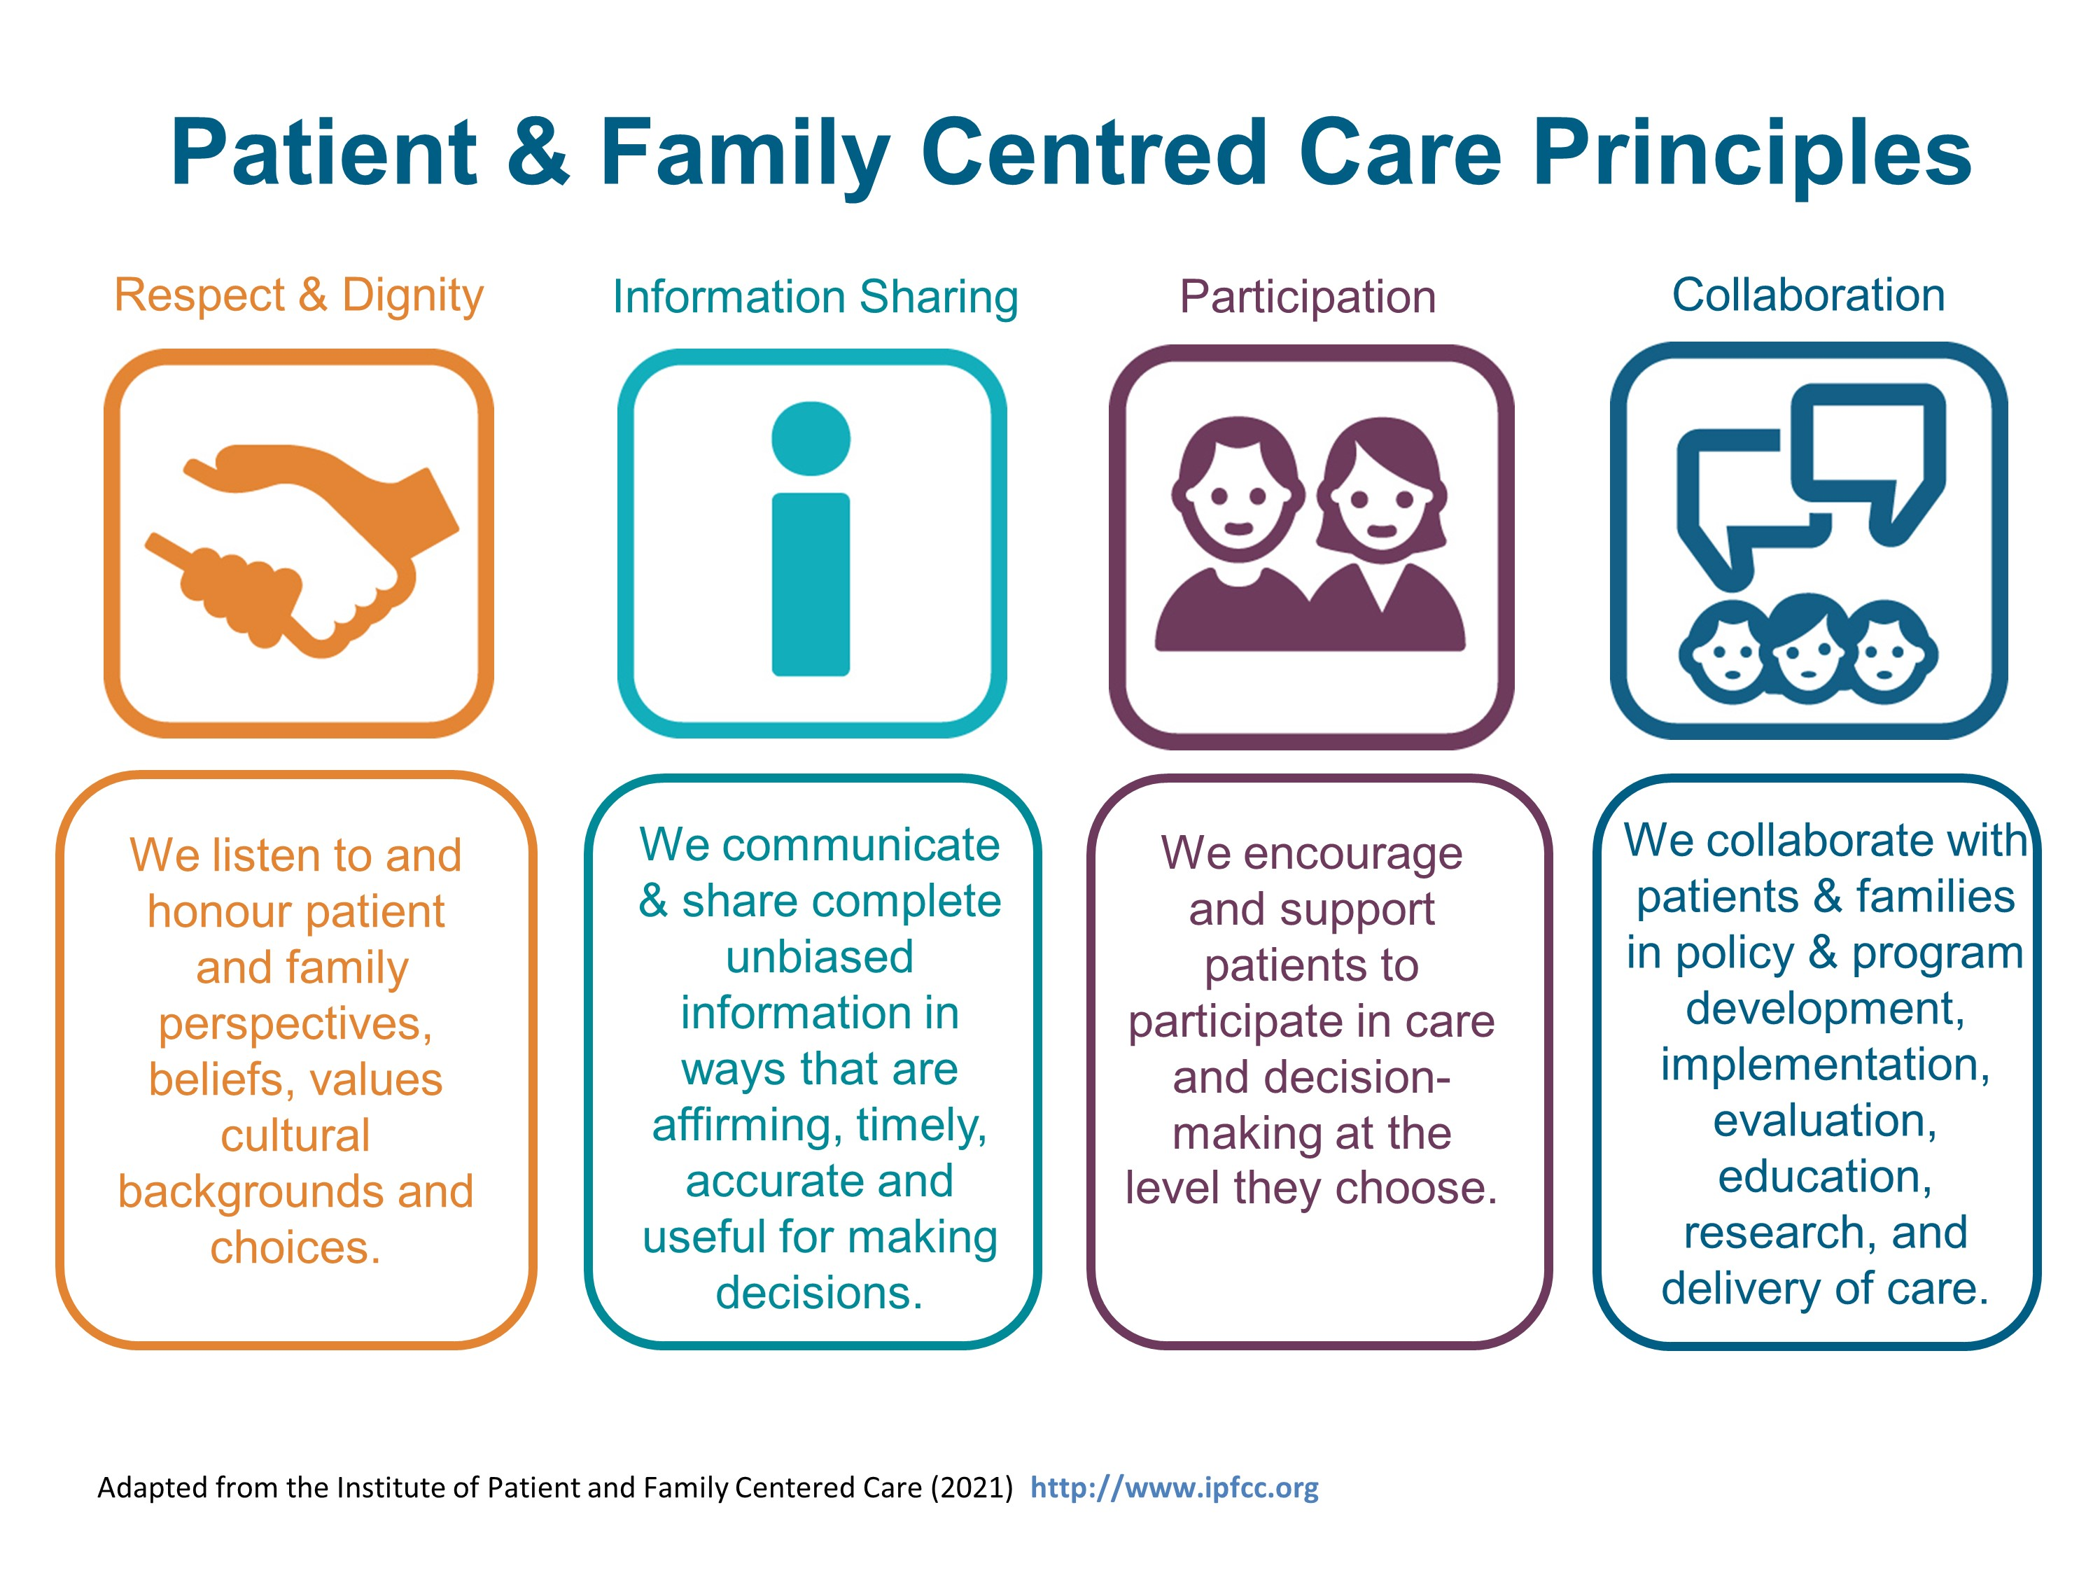


https://together4health.albertahealthservices.ca/pfccinaction
Notes:
Early 2000s gained traction and recognized as a key dimension in safe, high-quality health care.
-IPFCC main organization
-Example of PFCC in research: PCORI, patient-centered outcomes research institute, created in 2010- increase in research to measure patient-centered outcomes
In clinical care, patient narratives offer an opportunity for patient-centered care.
In research, qualitative studies can shed light on patient satisfaction and enhance patient-centered outcomes research by adding a new dimension to quantitative data.

Slide 11
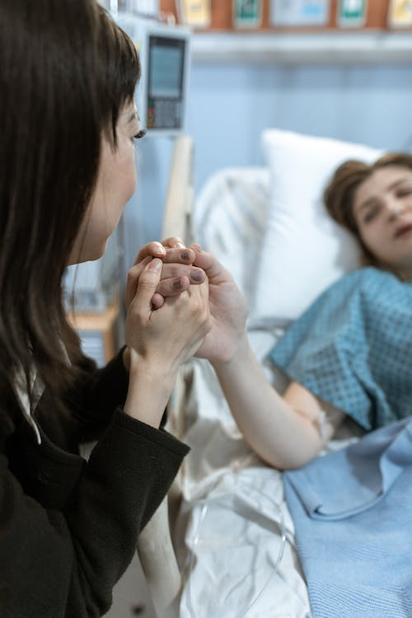
Illness Narratives at the Bedside
History of Present Illness
PQRST
Illness Scripts
https://www.pexels.com/photo/a-woman-holding-a-patient-s-hand-6129440/

Slide 12
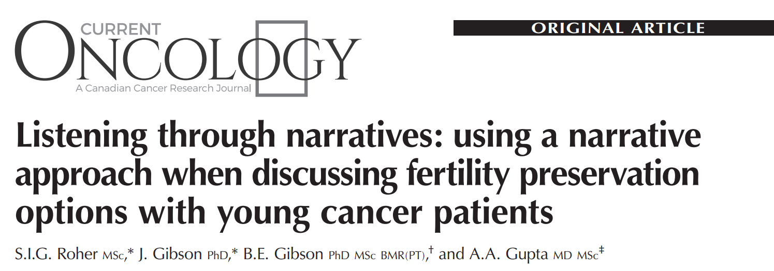
A Case Study: Male Survivors on Fertility Preservation Conversations
Notes:
I want to share one example of how eliciting patient narratives in research and applying Frank’s typology can help to inform clinical interventions. Research has shown that even when fertility preservation options are broached with adolescents, survivors often report dissatisfaction with those conversations, which raises concern about their content and their quality. A research team at the Hospital for Sick Children interviewed 15 adolescent male survivors of childhood cancer who were 14-18 years of age at the time and initially diagnosed before the age of 15. Questions revolved around how male adolescent childhood cancer survivor patients understand infertility as a long-term side effect of treatment and their perceptions of fertility preservation options.
This qualitative research study looked at how a narrative approach using the Frank typology could improve the quality of such conversations. The following slides show how identifying the type of illness narrative by participants (indicated in red speech bubbles) can help providers (indicated with black speech bubbles), to thoughtfully respond to the needs of adolescent patients.
--
Gupta AA, Donen RM, Sung L, Boydell KM, Lo KC, Stephens D, Pritchard S, Portwine C, Maloney AM, Lorenzo AJ. Testicular Biopsy for Fertility Preservation in Prepubertal Boys with Cancer: Identifying Preferences for Procedure and Reactions to Disclosure Practices. J Urol. 2016 Jul;196(1):219-24. doi: 10.1016/j.juro.2016.02.2967. Epub 2016 Mar 3. PMID: 26947434.
Roher SI, Gibson J, Gibson BE, Gupta AA. Listening through narratives: using a narrative approach when discussing fertility preservation options with young cancer patients. Curr Oncol. 2017 Feb;24(1):10-15. doi: 10.3747/co.24.3419. Epub 2017 Feb 27. PMID: 28270719; PMCID: PMC5330623.

Slide 13
A Case Study: Male Survivors on Fertility Preservation Conversations
Restitution:
“I want to live a more normal life. I don’t want to miss out on any experiences because of cancer. If fertility preservation offers a chance to not be held back, then let’s go for it.”
“I am hearing that you want to live a normal life. What does “normal” look like to you?”
Notes:
Participants expressed each of the narrative types at different points of their interviews, which is to be expected since no single interview is supposed to “fit” perfectly with any one narrative form. The Frank narrative types have previously been used to examine adult cancer narratives, but this study is the first to use this typology with adolescents.
Restitution narratives were the most dominant narrative type in the participant stories.
One participant said “I want to live a more normal life. I don’t want to miss out on any experiences because of cancer. If fertility preservation offers a chance to not be held back, then let’s go for it.”
The provider responded by reflecting back, “I am hearing that you want to live a normal life. What does “normal” look like to you?”
While adult cancer patients tell restitution narratives that often hope for a return to their pre-illness self, the adolescents in this study wanted to achieve restitution to the “normal” self they believe they would have been had they not had cancer. Instead of hoping to be restored to a former self, these participants saw family planning as an opportunity to achieve an imagined version of who they thought they might be.
--
Roher SI, Gibson J, Gibson BE, Gupta AA. Listening through narratives: using a narrative approach when discussing fertility preservation options with young cancer patients. Curr Oncol. 2017 Feb;24(1):10-15. doi: 10.3747/co.24.3419. Epub 2017 Feb 27. PMID: 28270719; PMCID: PMC5330623.

Slide 14
A Case Study: Male Survivors on Fertility Preservation Conversations
“Fertility preservation is awesome because it’s awesome, and it’s not good because of the chance that something bad might happen… Well, it’s cool but it’s, again, the risks there are probably high for parents and even the kid if they know what they’re talking about so….”
Chaos:
“It sounds as if you might be unsure right now about whether fertility preservation was the right choice for you. It’s ok to feel unsure.”
Notes:
Chaos narratives were the least common narrative type.
One participant describes how “Fertility preservation is awesome because it’s awesome, and it’s not good because of the chance that something bad might happen,” and he continues on to acknowledge that “it’s cool” but there are also risks.
The provider validates the participant’s uncertainty by paraphrasing and normalizes his mixed feelings by saying that “it’s ok to feel unsure.”
--
Roher SI, Gibson J, Gibson BE, Gupta AA. Listening through narratives: using a narrative approach when discussing fertility preservation options with young cancer patients. Curr Oncol. 2017 Feb;24(1):10-15. doi: 10.3747/co.24.3419. Epub 2017 Feb 27. PMID: 28270719; PMCID: PMC5330623.

Slide 15
A Case Study: Male Survivors on Fertility Preservation Conversations
“I appreciate my family so much. If I have the opportunity, I will seize it, and I will use it to the best of my ability. That’s why I [do/do not] want to preserve my fertility.”
Quest:
“It sounds as if you see yourself playing an active role in your life and that you are thinking about what is valuable and meaningful to you personally. Would you say that is true?”
Notes:
Quest narratives fell in the middle in frequency.
An example of a quest narrative is illustrated here when a participant expresses that “If I have the opportunity, I will seize it, and I will use it to the best of my ability.” The provider responds by empowering the patient and emphasizing the patient’s “active” role in decision-making and potential for control within the situation.
These examples illustrate how narrative types can be useful in identifying perspective and giving the listener a sense of direction in crafting supportive responses.
--
Roher SI, Gibson J, Gibson BE, Gupta AA. Listening through narratives: using a narrative approach when discussing fertility preservation options with young cancer patients. Curr Oncol. 2017 Feb;24(1):10-15. doi: 10.3747/co.24.3419. Epub 2017 Feb 27. PMID: 28270719; PMCID: PMC5330623.

Slide 16
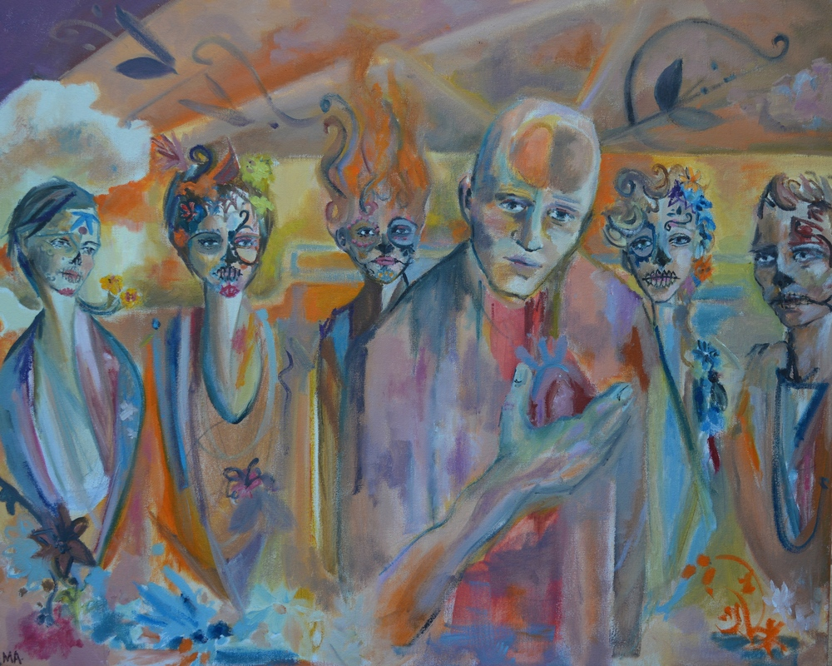
Writing Prompt
Pick a disease. Create a fictionalized illness narrative about the disease (ie. using the first person, personification, etc.)
Living In-Between, Mandy Archibald
https://www.theintima.org/living-in-between

Slide 17
Works Cited
Charon, Rita. Narrative Medicine: Honoring the Stories of Illness. Oxford: Oxford UP, 2006.
Hawkins, Anne Hunsaker. Reconstructing Illness: Studies in Pathography. West Lafayette, IN: Purdue UP, 1993.
Kleinman, Arthur. The Illness Narratives: Suffering, Healing, and the Human Condition. New York: Basic, 1988. Print.
https://together4health.albertahealthservices.ca/pfccinaction
Sontag, Susan. Illness as metaphor and AIDS and its metaphors. Farrar, Straus and Giroux. New York 1978
Roher SI, Gibson J, Gibson BE, Gupta AA. Listening through narratives: using a narrative approach when discussing fertility preservation options with young cancer patients. Curr Oncol. 2017 Feb;24(1):10-15. doi: 10.3747/co.24.3419. Epub 2017 Feb 27. PMID: 28270719; PMCID: PMC5330623.
Archibald, Mandy. Living In-Between. https://www.theintima.org/living-in-between

