Slide 1
HLEQ 430: Narrative Medicine and Health Inequity
Week 4: Living Beneath The Bell Jar of Depression and Mental Illness
Trisha K. Paul, MD
Spring 2023

Slide 2
How We Diagnose Mental Illness
Diagnostic and Statistical Manual of Mental Disorders (DSM-V)
Currently in 5th edition (published May 2013), TR
Used by mental health professionals in the U.S.
Included homosexuality until 1974 (DSM-II, seventh printing)
Asperger’s syndrome now part of Autism Spectrum Disorders

Slide 3
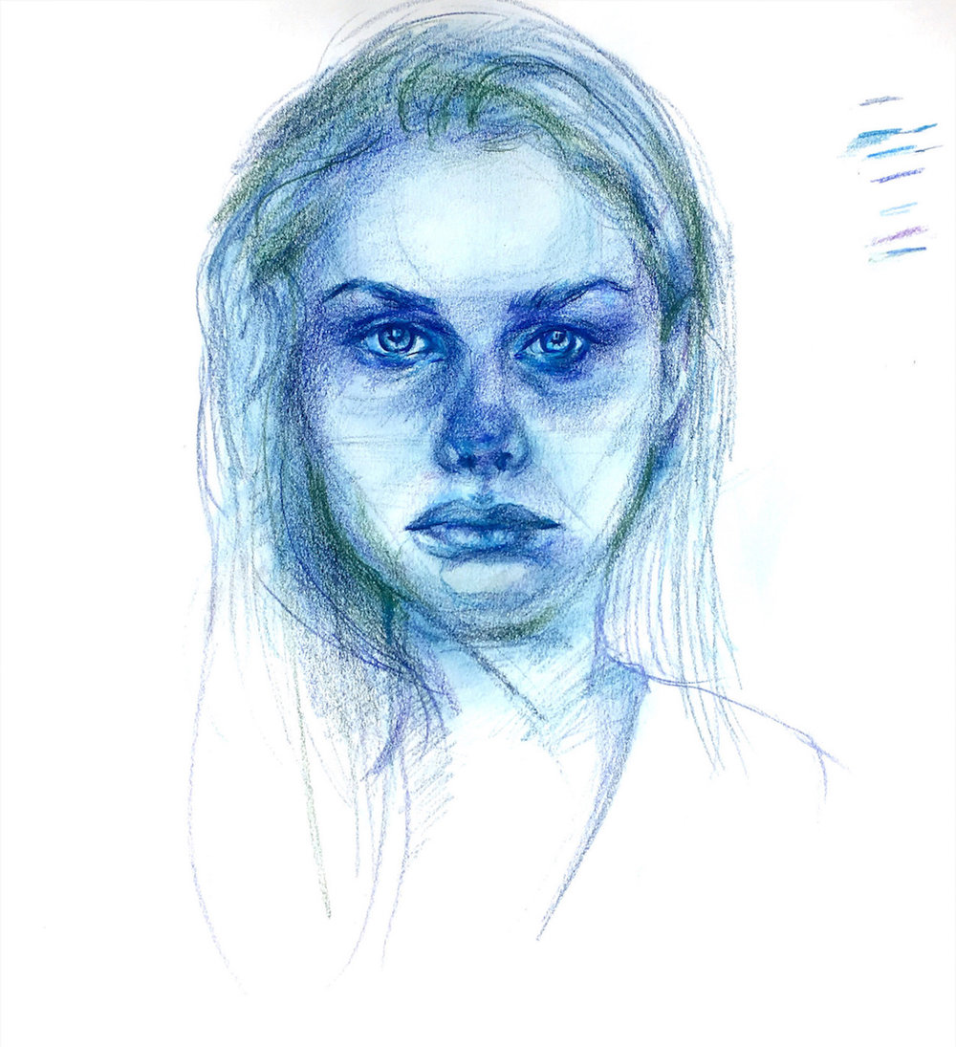
Depression, for example
Beyond Blue, Alice Wang
https://www.theintima.org/beyond-blue
Notes:
Major Depressive Disorder (MDD)
Incorporated into DSM-III in 1980
Depressed mood most of day, hopelessness, despair, fatigue, etc.
SIGECAPS:
PHQ9 screening form
At least 2 weeks of 5/9 symptoms (time parameter, criteria)
DSM V removed “Bereavement exclusion” (DSM-IV depression not diagnosed within 2mo of death of loved one)

Slide 4
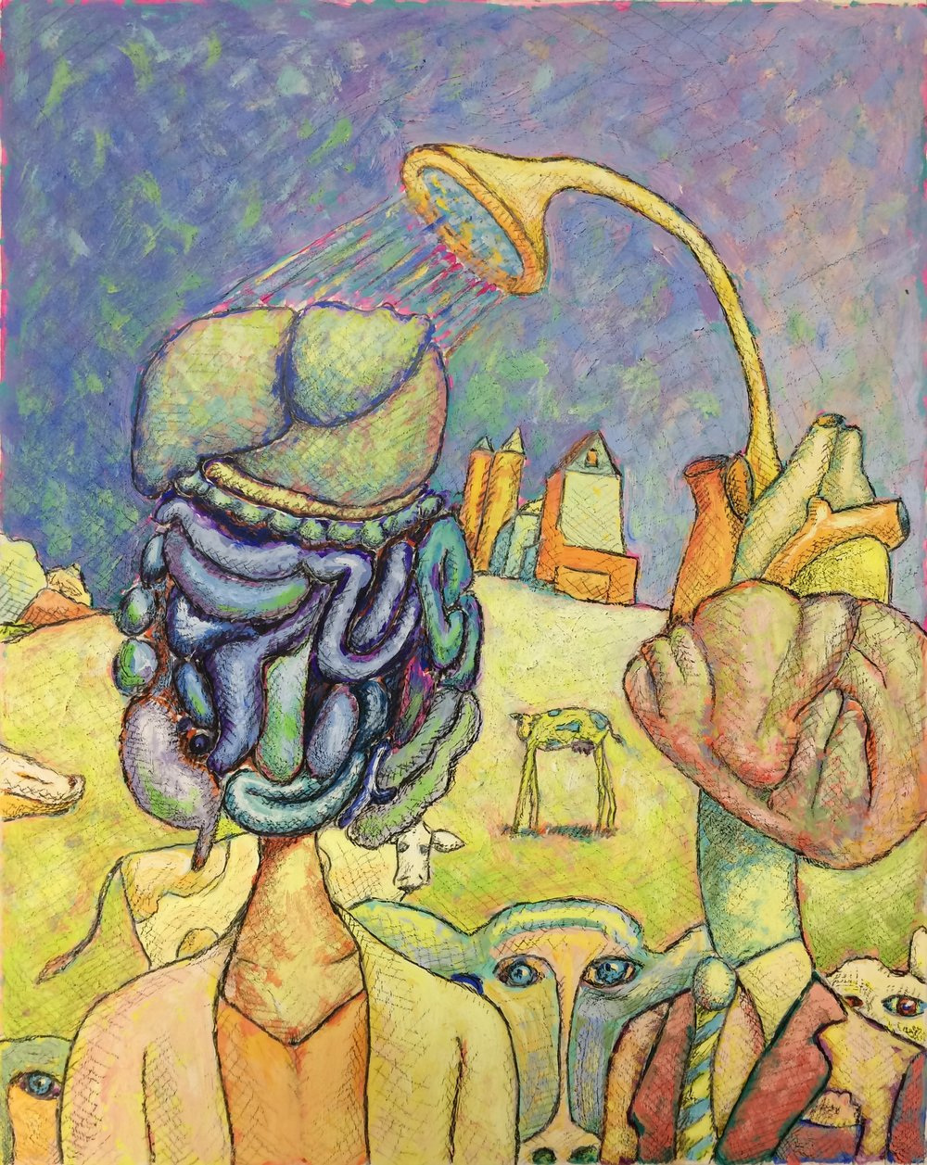
Considerations
Normal vs. Abnormal
Subjective distress
Functional impairment
How we treat
Inner Fortitude, Ronald Walker
https://www.theintima.org/inner-fortitude

Slide 5
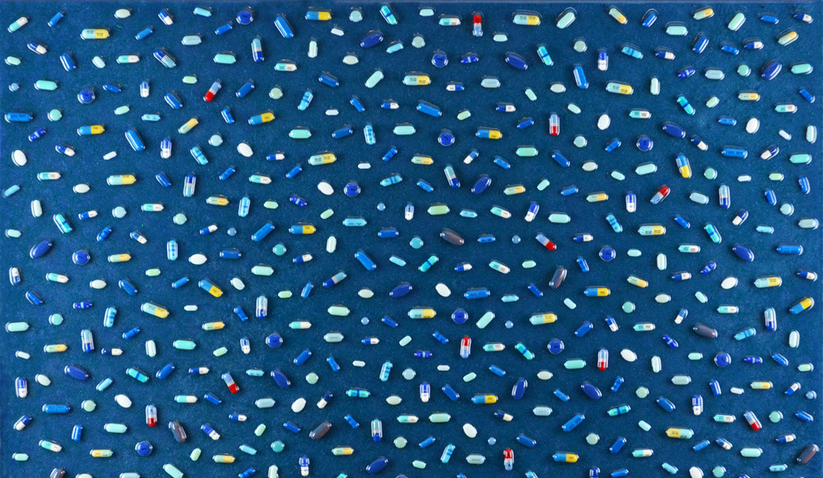
Stigma:
“to carve, to mark as a sign of shame, punishment or disgrace”
-Erving Goffman
Side Effects, Tina La Porta
https://www.theintima.org/new-page-19
Notes:
“bodily signs designed to expose something unusual and bad about the moral status of the signifier. The signs were cut or burnt into the body and advertised that the bearer was a slave, a criminal, or a traitor—a blemished person, ritually polluted, to be avoided, especially in public places.” –Erving Goffman
Now: “applied more to the disgrace itself than to the bodily evidence of it” (1-2)
Where does stigma originate from, and what influences stigma? Many kinds of stigma exist.
--
What might some examples of visible stigma be? Of invisible stigma?
How might these experiences of stigma differ?
Goffman describes three types: (1) stigma associated with mental illness; (2) stigma associated with physical deformation; and (3) stigma attached to identification with a particular race, ethnicity, religion, ideology,

Slide 6
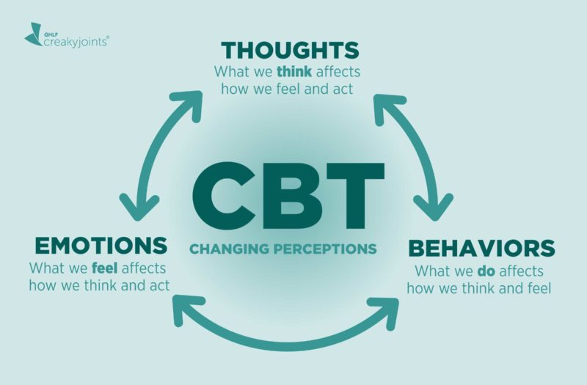
Cognitive Behavioral Therapy (CBT)
https://creakyjoints.org/living-with-arthritis/mental-health/cognitive-behavioral-therapy-for-arthritis/

Slide 7
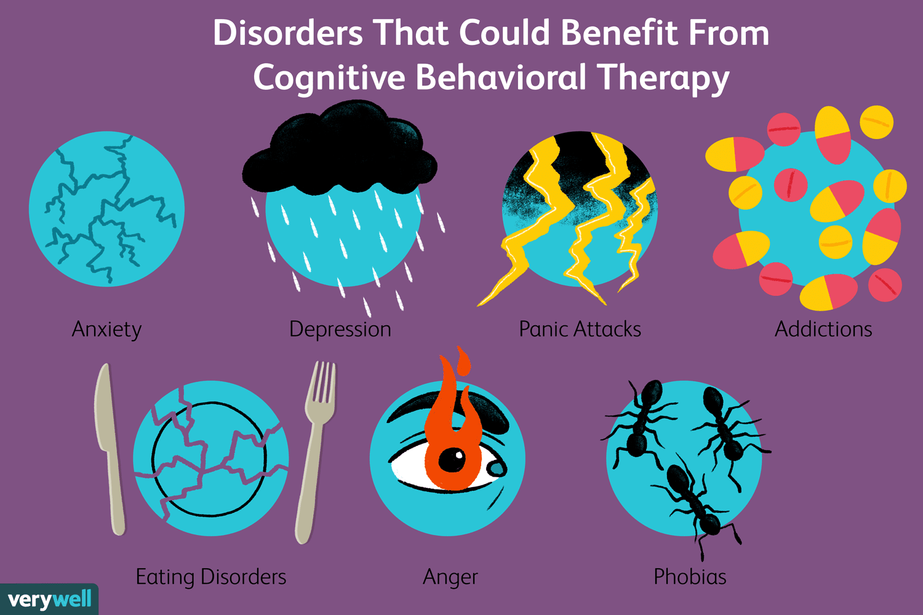
https://www.verywellmind.com/what-is-cognitive-behavior-therapy-2795747

Slide 8

Mental Health Stigma Rooted in Korean Culture:
A Korean American's visual reflection

Slide 9
Works Cited
Alice Wang, Beyond Blue. https://www.theintima.org/beyond-blue
Tina La Porta, Side Effects. https://www.theintima.org/new-page-19
https://creakyjoints.org/living-with-arthritis/mental-health/cognitive-behavioral-therapy-for-arthritis/
https://www.verywellmind.com/what-is-cognitive-behavior-therapy-2795747
Mandy Archibald. Living In-Between. https://www.theintima.org/living-in-between
Julie Hwang, MENTAL HEALTH STIGMA ROOTED IN KOREAN CULTURE: A Korean American's visual reflection using Hangul, the Korean alphabet. https://www.theintima.org/mental-health-stigma-rooted-in-korean-culture-julie-hwang

