Slide 1
HLEQ 430: Narrative Medicine and Health Inequity
Week 6: Narratives of Health Inequity in Medical Education
Trisha K. Paul, MD
Spring 2023
Notes:
Parking lot

Slide 2
Three Questions
How do we respond to these narratives in real-time?
How do we amplify the voices of those experiencing health inequity related to race?
How do we change the dominant narratives about racial inequity?

Slide 3
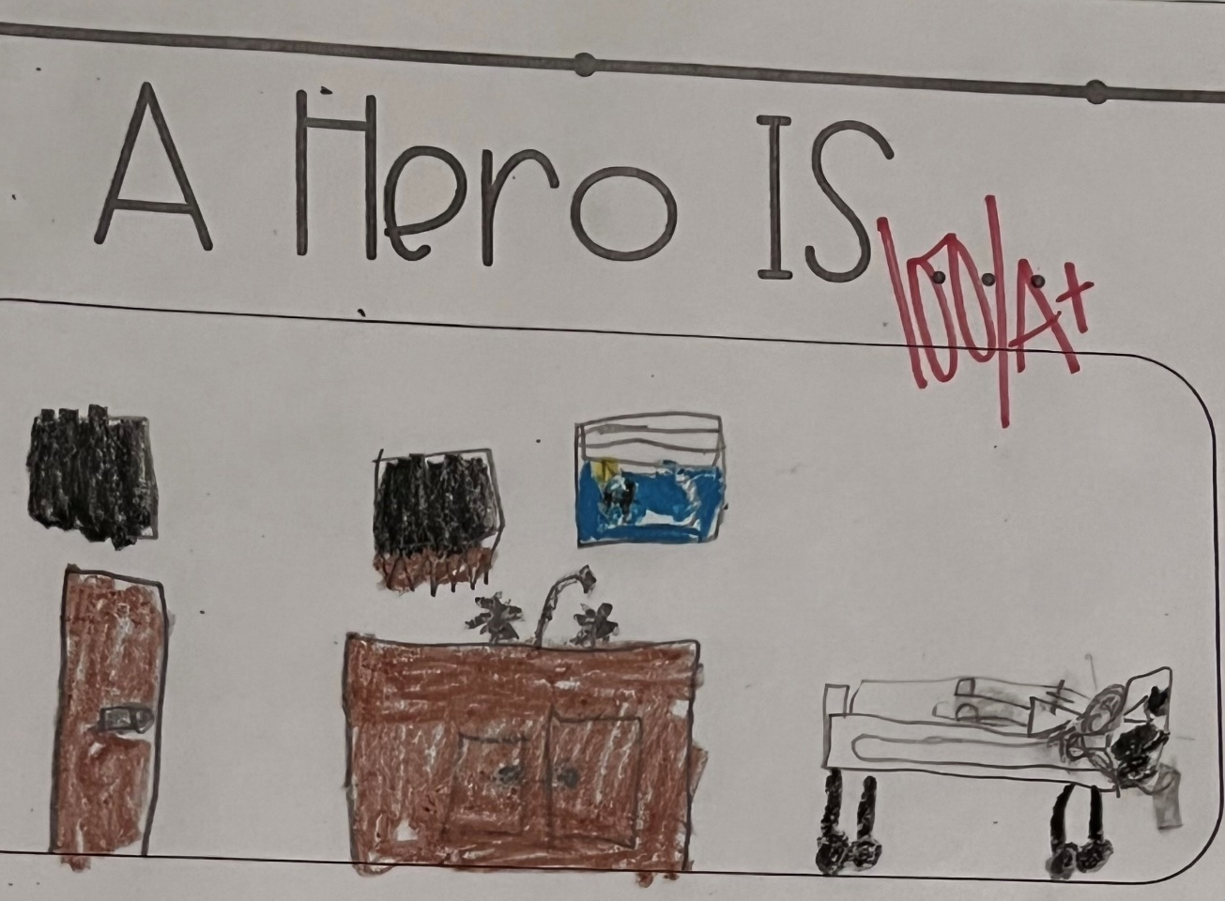

The Hero Narrative
Notes:
Last week, we touched upon the idea of the hero narrative. This is a school assignment that one of my primary patients gave to me when I saw her three months after she was cured of her cancer and back in school this fall.
I want to challenge the idea of the hero narrative. What are problems that come with the narrative of physicians as heroes?
How does this narrative affect providers? How does it affect how society perceives providers and what is expected of them?
-COVID pandemic response to HCW- work more, in potentially unsafe conditions, because we have to care for people
-places a heightened level of importance on the doctor/provider as an individual
-healthcare system often takes advantage of the altruistic nature of those in our profession
--i.e. many do not have time protected to do all the things that are expected of them.
-high rates of stress, depression, burnout, especially when we are unable to “save”

Slide 4
Nonabandonment
“She kept returning to the particular, those particular people in whose bodies the policy and public health and personal story seemed to crystallize, and who were dying in makeshift houses up and down the Texas coast.”(56)
Notes:
Dr. Pearson touches upon the idea of nonabandonment that is engrained into the culture of medicine and our duty as providers.
Ie Dr. Susan McCammon working at an institution that no longer considers “charity care’ as part of its core mission, but she doesn’t feel like she can leave because then she would be abandoning her patients who need her. Physicians are positioned to bridge public health and policy with patient care, but doing so is challenging. Home visits are a part of routine hospice medical care, but if not practicing through hospice, physicians aren’t necessarily covered by malpractice insurance, so it is important to recognize that what Dr. McCammon did is not without risk.
A side note to consider: How might the nonabandonment expectation affect physicians when we experience racism or sexism coming from our patients?

Slide 5
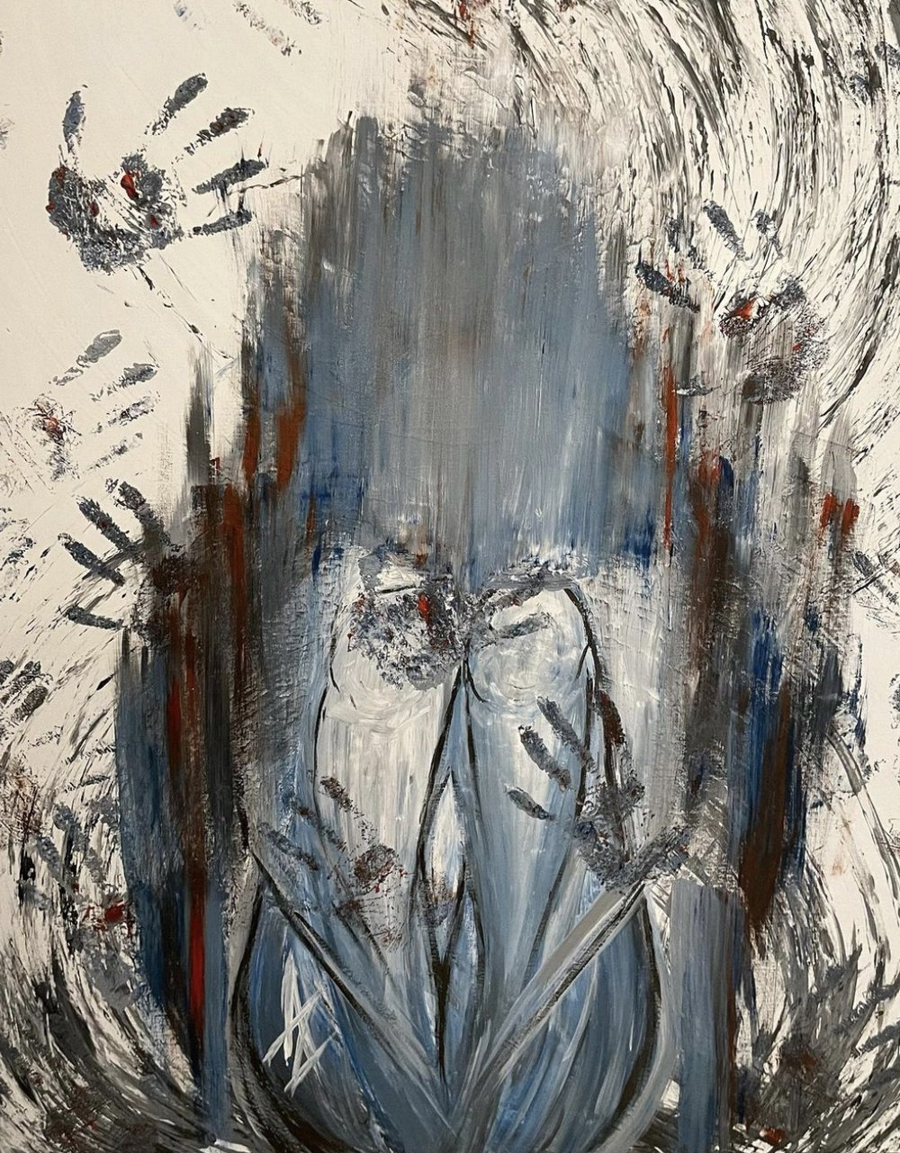
“Cancer is tangible, vicious and real; bureaucracy is otherwise. It is deliberately designed to obfuscate, to be the smoke that nobody can grasp” (56)
Untouchable by Azhar Alhashim. Intima Fall 2022
Notes:
Physicians are not always best equipped with the expertise or time and bandwidth to address the bureaucracy affecting all their pateints, and it is something we have to prioritize and decide for ourselves how we want to address. Often, this means fiercely advocating for the individuals in front of us even if we can’t always fix the system.
It is important to know who to lean on within the system and within your team.
A recent example from my own experience- my primary patient is located in a group home in MS and sees me for a hematologic disorder. She is under the custody of another state’s child protective services. I found out that she has not been receiving any primary care pediatrics and was only seeing me as a hematologist. Her group home said all the clinics in her area were out of network so they couldn’t take her anywhere. I called her child services representative multiple times and couldn’t get a hold of her. Our social worker was able to spend more hours tracking down DCS and establishing next steps.
https://www.theintima.org/untouchable-azhar-alhashim-fall-2022-intima

Slide 6
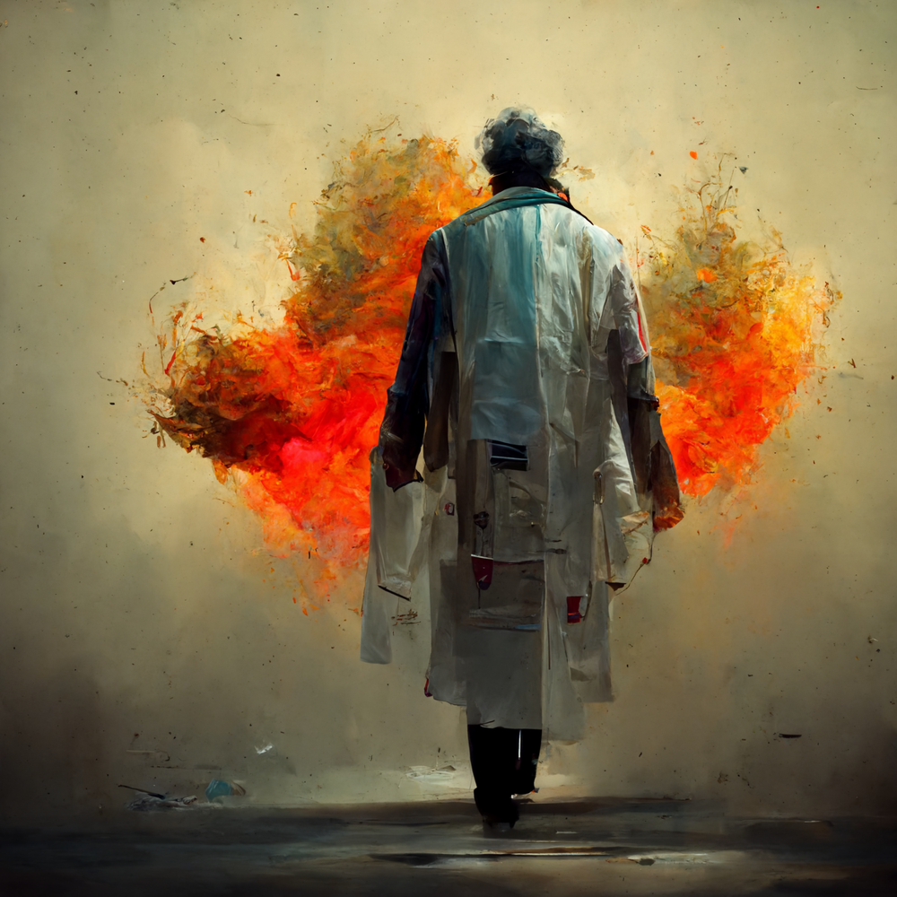

Practicing as an Individual & as a Team
Burnout 1 and 3, Brian Smith. Intima Fall 2022.
Notes:
Providers build up their knowledge and expertise and want to do what is best for a patient. Teams are made up of many different providers, and sometimes different providers think different things are in the patient’s best interest. This is where the idea of ego can come in, because individuals can have different perspectives on what is best and many answers are not clear cut. This is important because it leads to breakdown in communication with patients and mixed messaging.
You can imagine that barriers that limit our ability to best care for patients the way we believe we should are frustrating. It is normal to have emotional responses to these barriers, be in insurance or poverty or food deserts, but there are healthy ways to acknowledge these emotions and unhealthy ways that people “cope” by blaming patients.
Sometimes, being a part of a team means that we have to be careful about the team dynamic because we can’t abandon the needs of the patients. Sometimes this affects how people respond in real-time.
https://www.theintima.org/burnout-brian-smith-fall-2022-intima

Slide 7
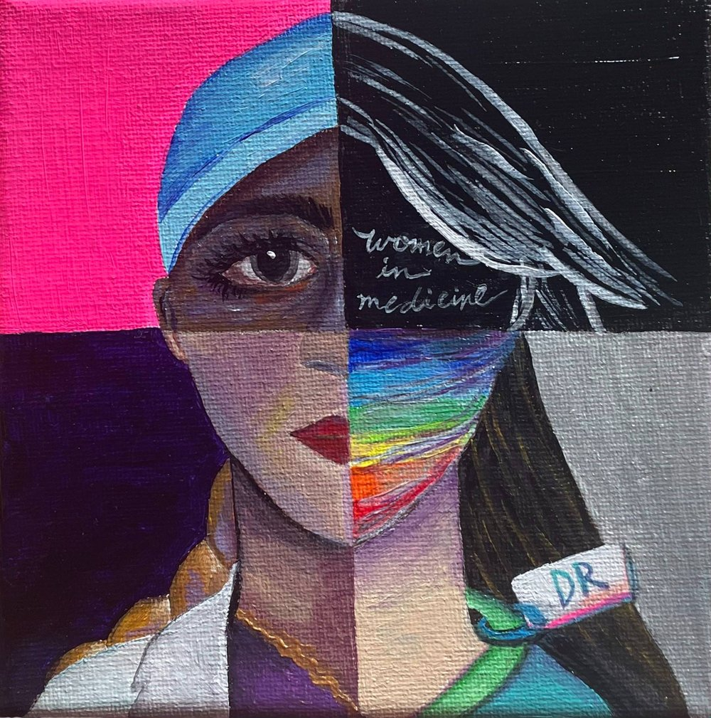
Ultimately, what is best for the patient?
The Common Thread, Medha Cherabuddi. Intima Fall 2022.
Notes:
I took care of a family from Ukraine this week. He had come to St. Jude but his disease progressed after transplant and there were no curative treatment options left, so family wanted to return home. We were getting ready to have a conversation about the patient’s code status before he flew home on a commercial airlines. The nurse practitioner said that the family would better receive the conversation if it came from a man, so our attending led the conversation instead of me as the fellow in training.
https://www.theintima.org/common-thread-medha-cherabuddi
What do you think about that?

Slide 8
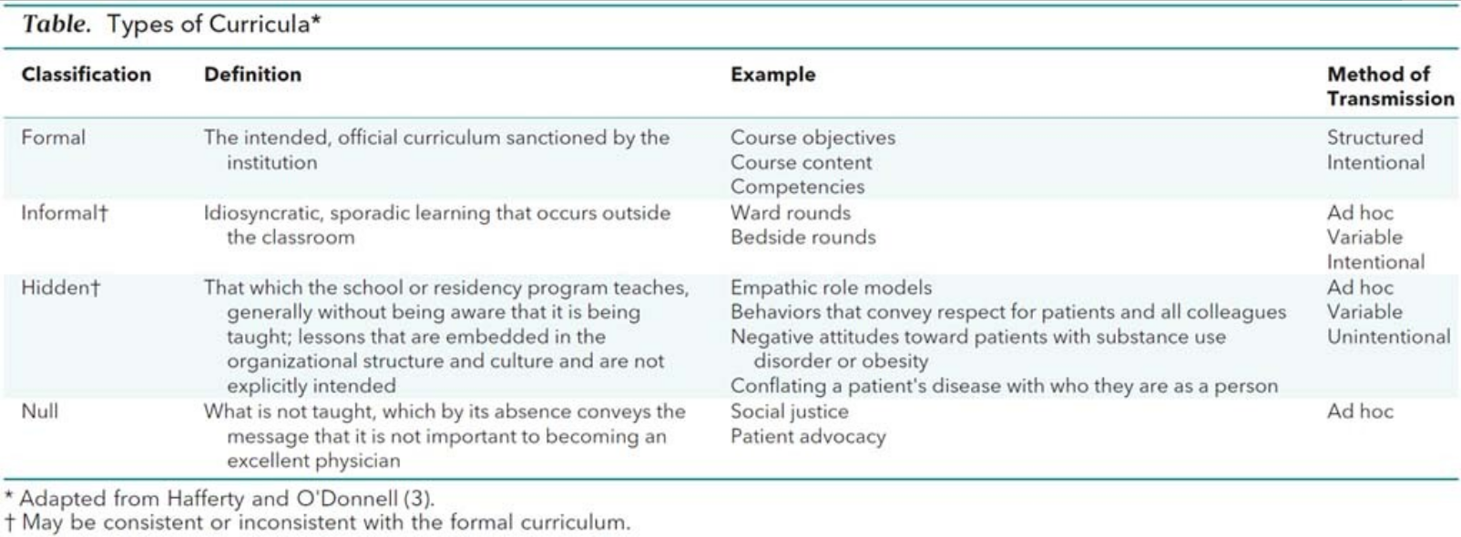
The “Hidden Curriculum”: disconnects between what is taught and demonstrated
Lehman et al. 2018
Notes:
I think it’s helpful to understand the concept of the hidden curriculum in medical education. The idea is that there are “disconnects between what [they were] taught about professional behaviors/attitudes and what [theysaw] being demonstrated by faculty”. In 2016, more than half of medical school graduates perceived that they receive conflicting messages about ethics and professionalism when the actions or words of role models are not consistent with the values espoused by the profession.
“the culture of medicine” is passed down, some examples of the hidden curriculum are postitive, like the PCP who visits her hospitalized patients and some are negative, like a provider making disparaging comments about frequently admitted patients.
How is this article limited in how it talks about the Hidden Curriculum? Ie. given the fact that this is written by certain medical bodies, the examples provided, the purpose and goals of creating this policy
Lehmann LS, Sulmasy LS, Desai S; ACP Ethics, Professionalism and Human Rights Committee. Hidden Curricula, Ethics, and Professionalism: Optimizing Clinical Learning Environments in Becoming and Being a Physician: A Position Paper of the American College of Physicians. Ann Intern Med. 2018 Apr 3;168(7):506-508. doi: 10.7326/M17-2058. Epub 2018 Feb 27. PMID: 29482210.

Slide 9
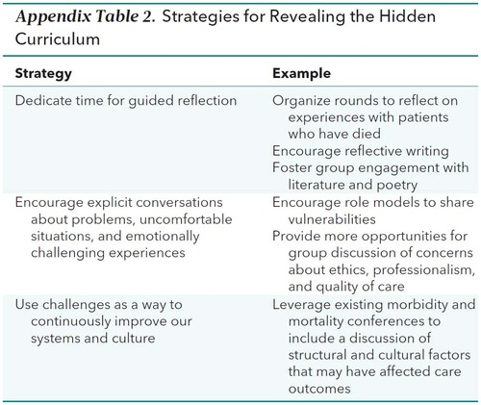
Narrative Medicine illuminates the “Hidden Curriculum”
Lehman et al. 2018
Notes:
Remembrance Rounds
We talk about how we cope and how we don’t cope when our patients die. We talk about how we remember them.

Slide 10
Three Questions
How do we respond to these narratives in real-time?
How do we amplify the voices of those experiencing health inequity related to race?
How do we change the dominant narratives about racial inequity?

Slide 11
Writing Prompt
Write a story about the first time you realized you wanted to study and advocate for health equity. Pay special attention to the emotions you felt and how they influenced you.

Slide 12
Works Cited
Pearson, Rachel. No Apparent Distress: A Doctor's Coming-of-Age on the Front Lines of American Medicine. W. W. Norton & Company. May 9, 2017.
Untouchable, Azhar Alhashim. Intima Fall 2022. https://www.theintima.org/untouchable-azhar-alhashim-fall-2022-intima
Burnout 1 and 3, Brian Smith. Intima Fall 2022. https://www.theintima.org/burnout-brian-smith-fall-2022-intima
The Common Thread, Medha Cherabuddi. Intima Fall 2022.. https://www.theintima.org/common-thread-medha-cherabuddi

Slide 13
Works Cited
Lehmann LS, Sulmasy LS, Desai S; ACP Ethics, Professionalism and Human Rights Committee. Hidden Curricula, Ethics, and Professionalism: Optimizing Clinical Learning Environments in Becoming and Being a Physician: A Position Paper of the American College of Physicians. Ann Intern Med. 2018 Apr 3;168(7):506-508. doi: 10.7326/M17-2058. Epub 2018 Feb 27. PMID: 29482210.

